Slide 1
Project 2: Universal Corporate Diagnostic

Slide 2
We need to shift from functional expertise ... to building capacity in organizations.
Project 2: Universal Corporate Diagnostic

Slide 3
How Can We Rewire Our Work?
We used to look at engagement data to understand culture – that’s playing in the functional expertise zone.
Now we can actually integrate this with customer data, brand data and more, then we have a holistic picture of the whole organization.
Affordable
Fast
Actionable
Real Time
Project 2: Universal Corporate Diagnostic
Notes:
Examples: customer data and brand data

Slide 4
Case Study
Challenges:
CEO needed to update business model to address disruption
Traditional discovery methods were inadequate to address the level of insight needed
What we did:
Conducted design of the interview to results in less than six weeks
Included existing data to identify misalignments
Highlighted problem areas and validated hypotheses with data
Collected over 8000 comments with over 4000 recommendations for improvement
Outcomes:
Massive effort to ensure alignment to the strategy at all levels
Overhaul of leadership model
New focus on customer experience and making it part of their DNA
Project 2: Universal Corporate Diagnostic

Slide 5
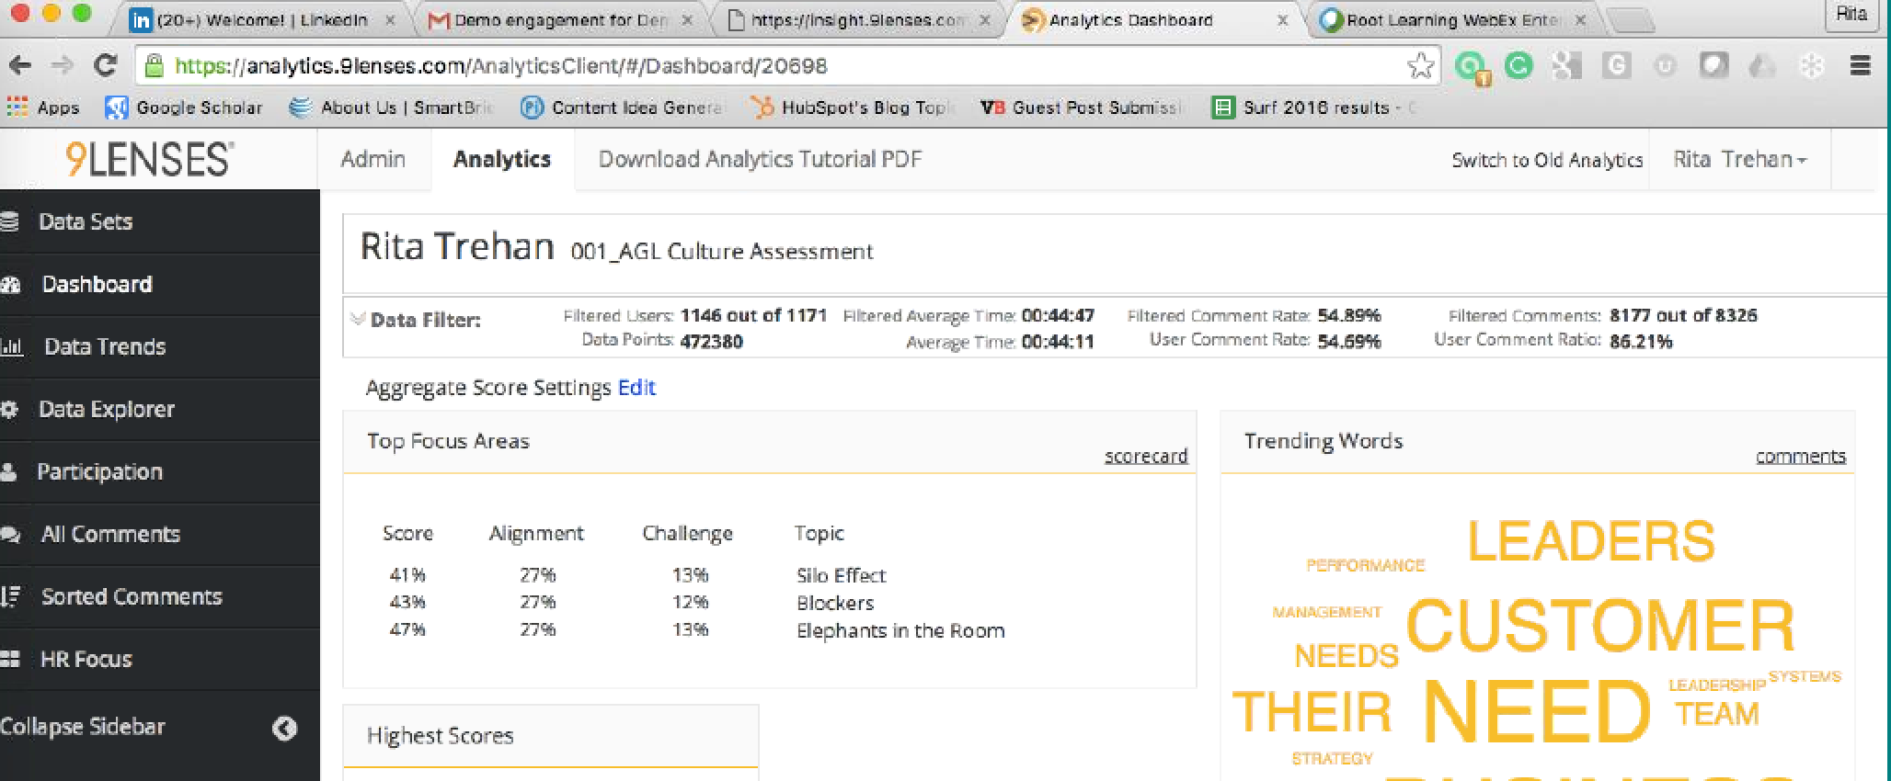
What it Looks Like
Project 2: Universal Corporate Diagnostic

